Slide 1


Introduction to Operating Systems CS 1550
Spring 2023
Sherif Khattab
ksm73@pitt.edu
(Some slides are from Silberschatz, Galvin and Gagne ©2013)

Slide 2
Announcements
Upcoming deadlines
Homework 3 is due this Friday
Lab 1 is due on Tuesday 2/7 at 11:59 pm
Project 1 is due on Friday 2/17 at 11:59 pm
Discussed in this week’s recitations
AFS Quota
You can check it using the command fs quota
You can increase it from accounts.pitt.edu.
Check README of Lab 1

Slide 3
Previous lecture …
How processes (threads) are created and terminated
Tracing programs with fork() calls

Slide 4
Problem of the Day
Bounded Buffer Problem
aka Producers Consumers Problem
A shared circular-array buffer with capacity n
A set of producer processes/threads
As set of consumer processes/threads
Requirements:
Never exceed the buffer capacity
Producers wait if the buffer is full
Consumers wait if the buffer is empty

Slide 5
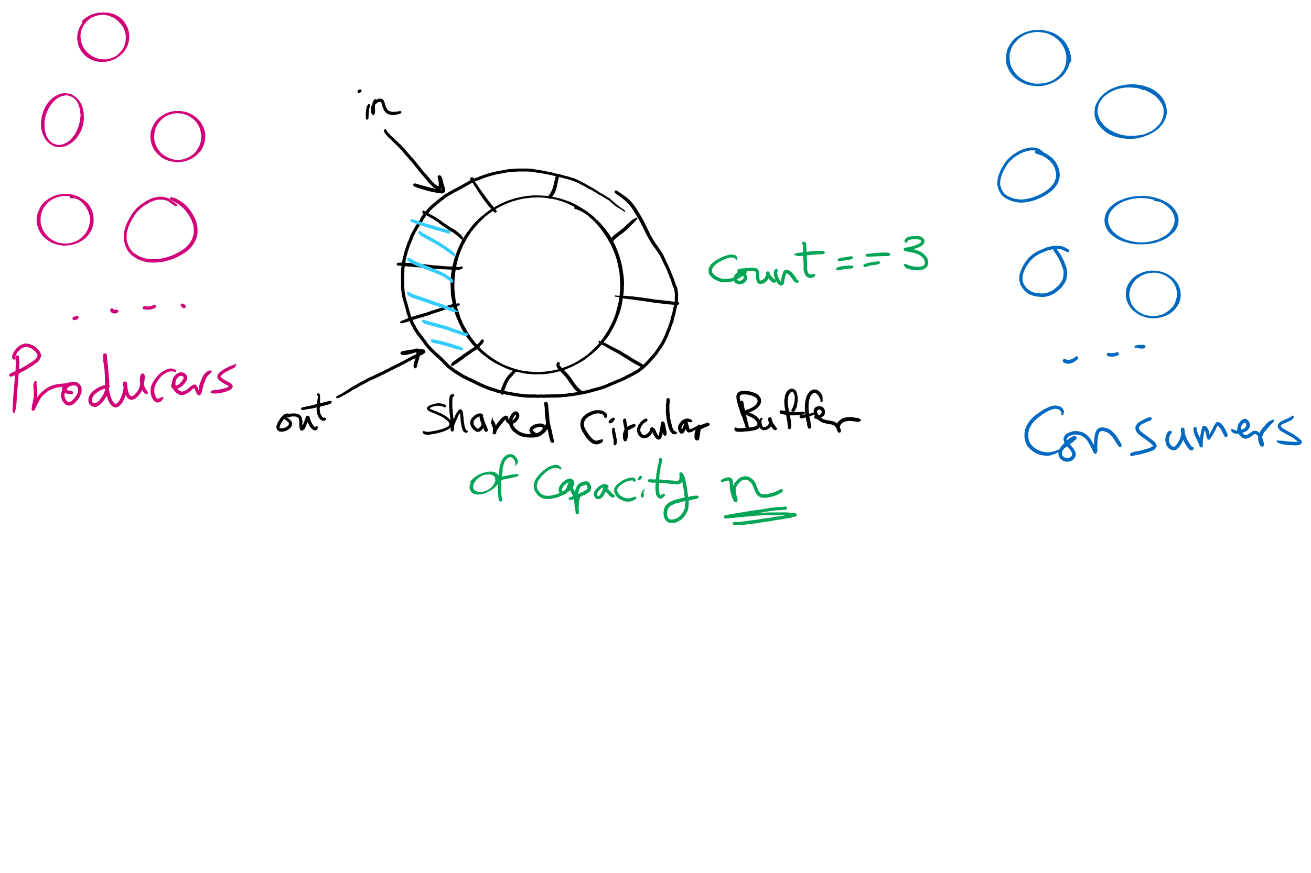
Produces Consumers Problem

Slide 6
Produces Consumers Problem

Slide 7
Produces Consumers Problem

Slide 8
Producers Consumers Problem is everywhere!
Access to User Interface elements in mobile applications
Main UI thread
Background threads
e.g., download files, check email on mail server
Background threads send requests to UI thread to update UI elements
Requests are stored in a shared bounded buffer
Which threads are the producers?
Who threads are the consumers?

Slide 9
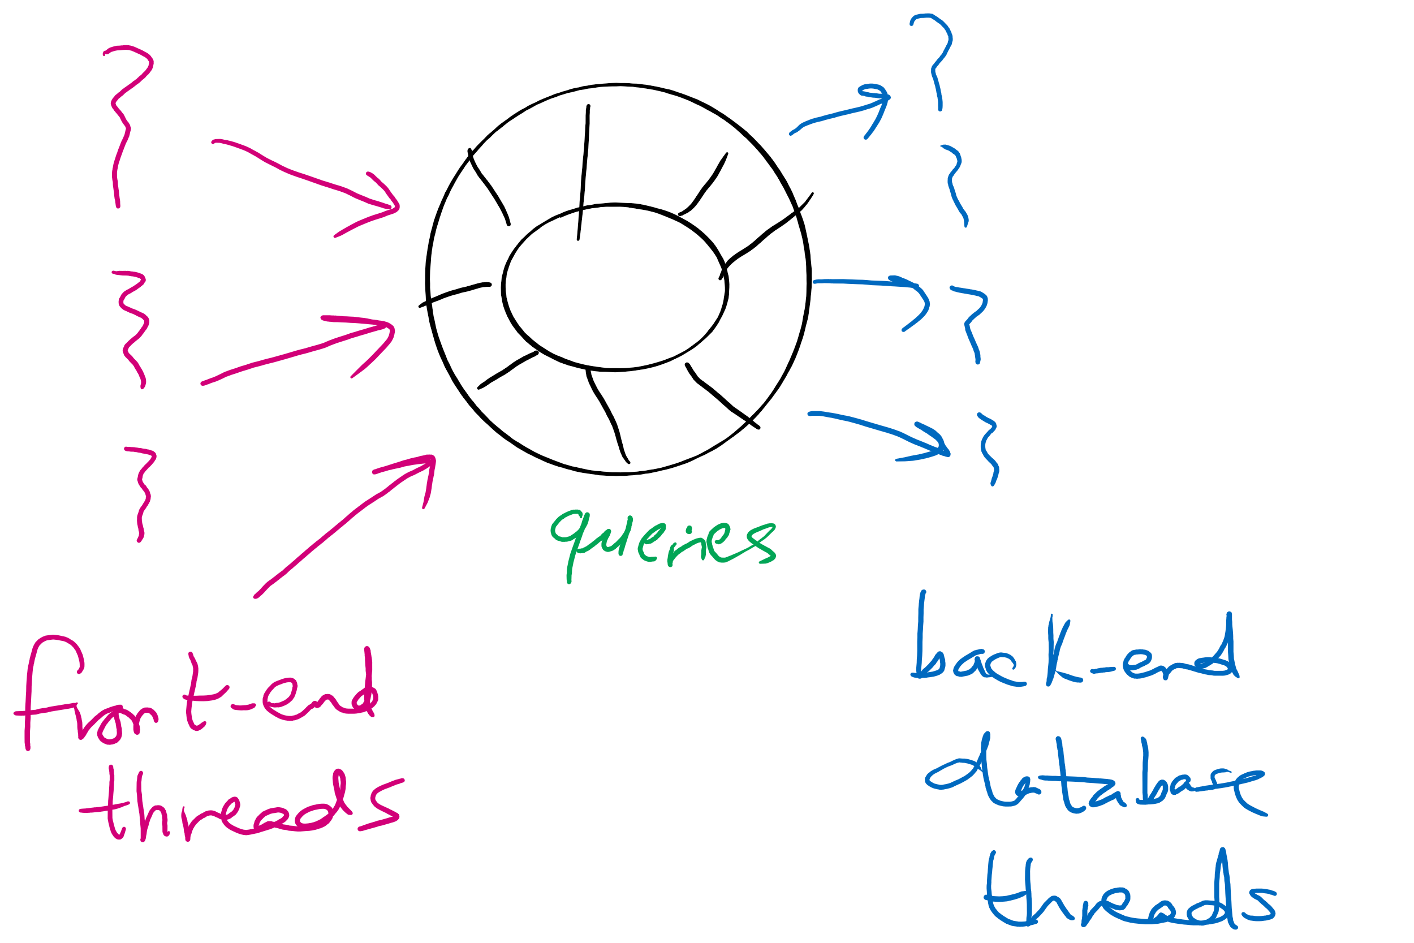
Producers Consumers Problem is everywhere!
Web Server
front-end processes/threads that interact with the HTTP connection from the client (e.g., browser)
Back-end processes/threads that execute database queries
Queries are inserted by front-end processes into a shared buffer
Which threads are the producers?
Who threads are the consumers?

Slide 10
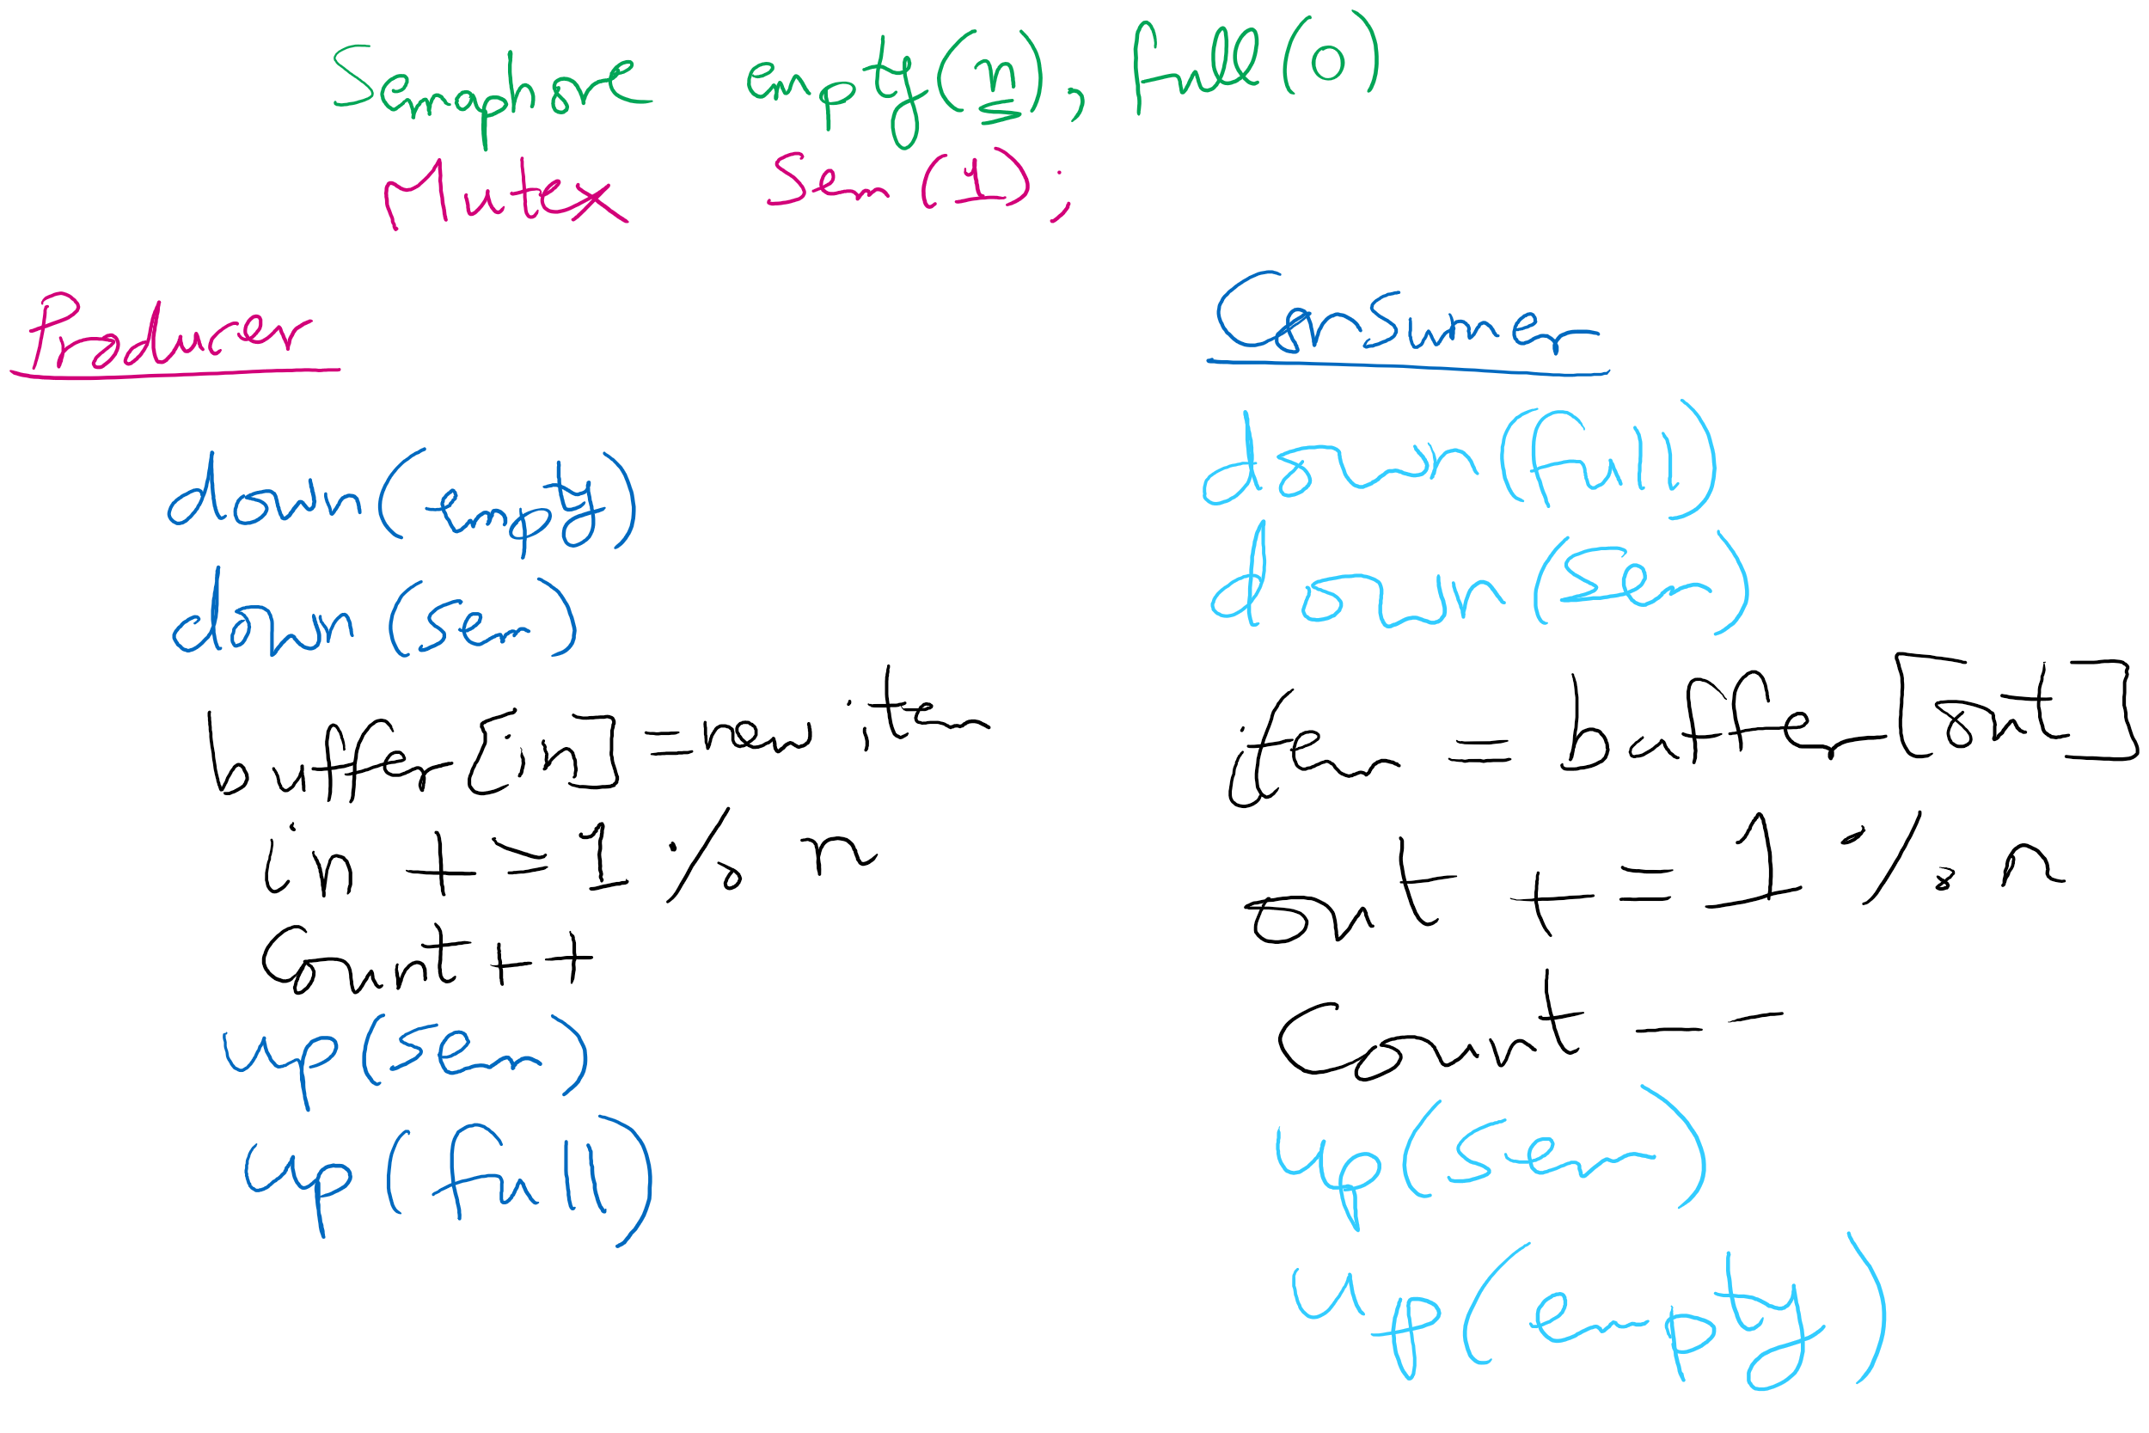
Solving Producers Consumers using Semaphores

Slide 11
Solving Producers Consumers using Semaphores

Slide 12
Solving Producers Consumers using Semaphores

Slide 13
Let’s trace the solution!
Let’s define some events first

Slide 14
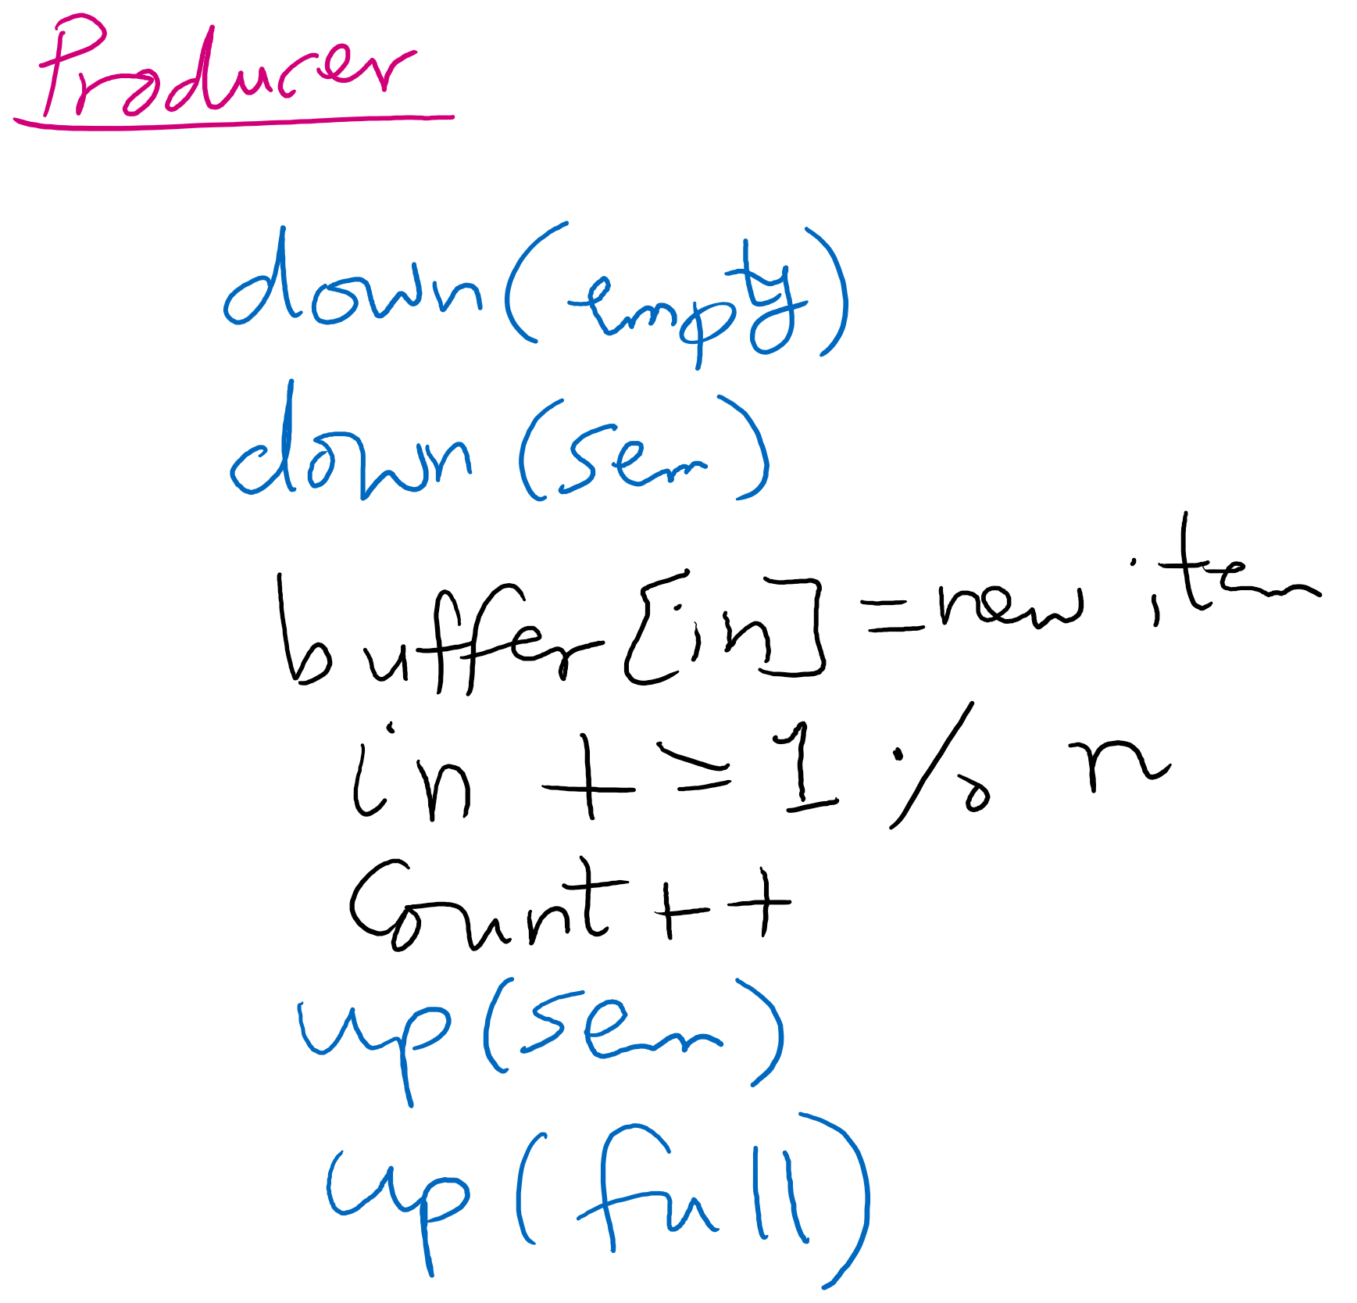
Producer arrives
Moves as far as possible until the solid line

Slide 15
Producer enters
Moves as far as possible past the solid line and until the dashed line

Slide 16
Producer leaves
Moves as far as possible until the dotted line

Slide 17
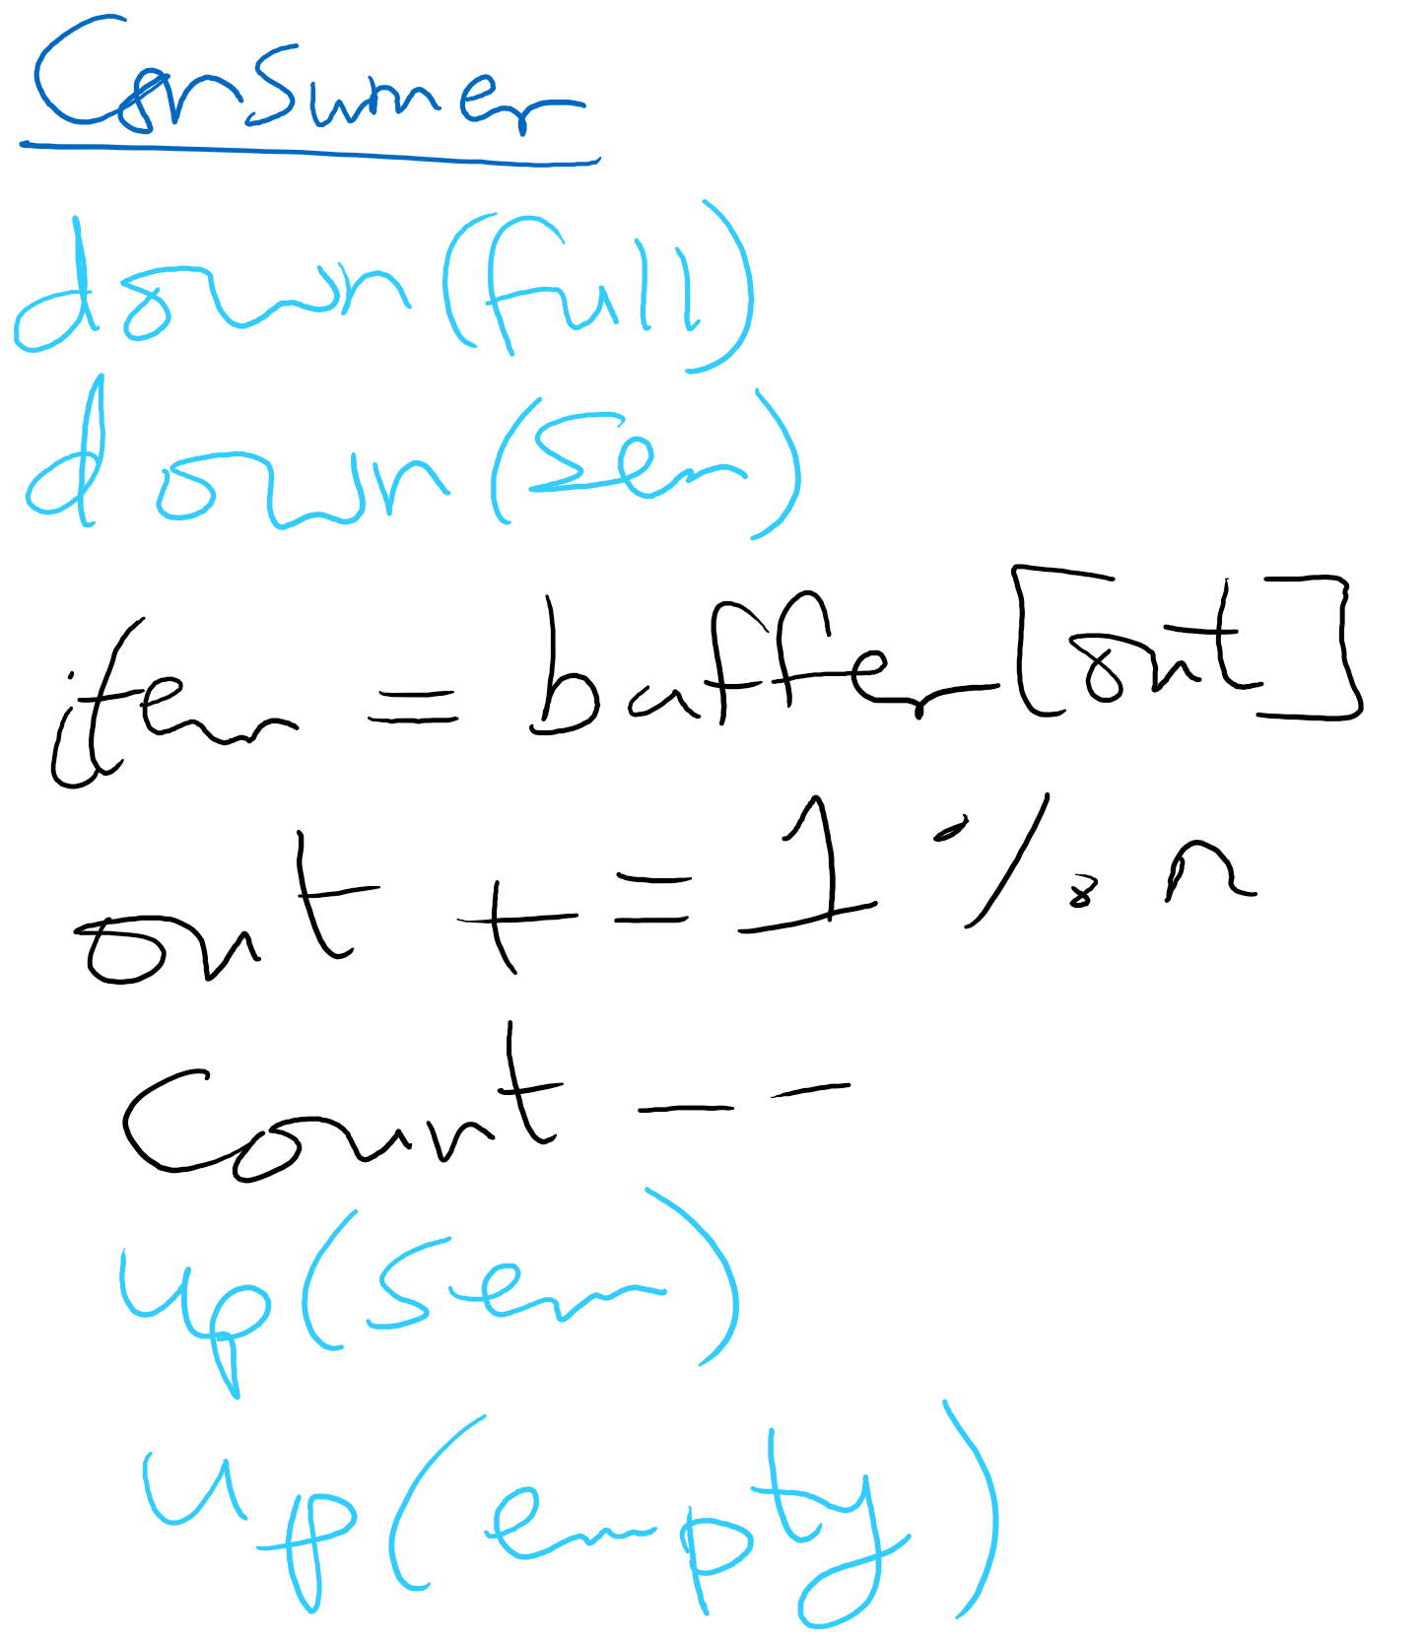
Consumer arrives
Moves as far as possible until the solid line

Slide 18
Consumer enters
Moves as far as possible past the solid line and until the dashed line

Slide 19
Consumer leaves
Moves as far as possible past the dashed line and until the dotted line

Slide 20
Tracing
Given a sequence of events, is the sequence feasible? If yes, what is the system state at the end of the sequence?

Slide 21
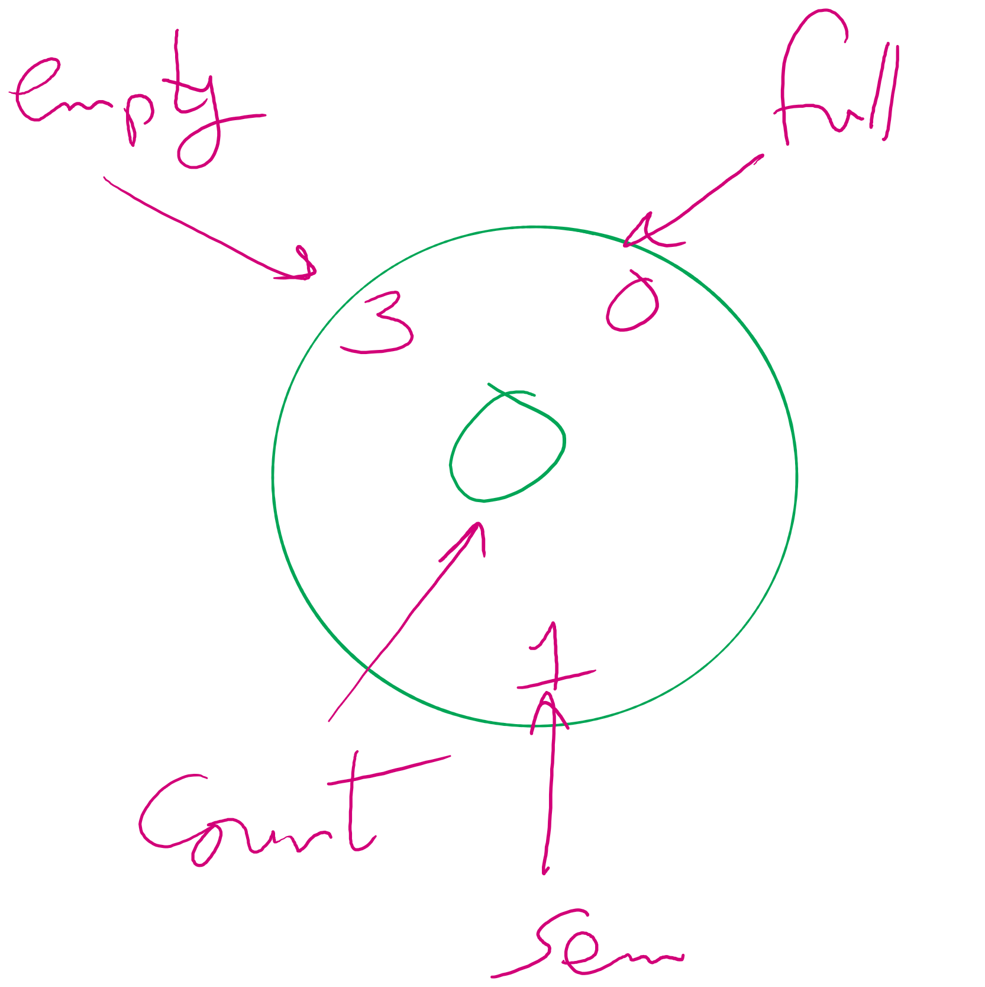
System State

Slide 22
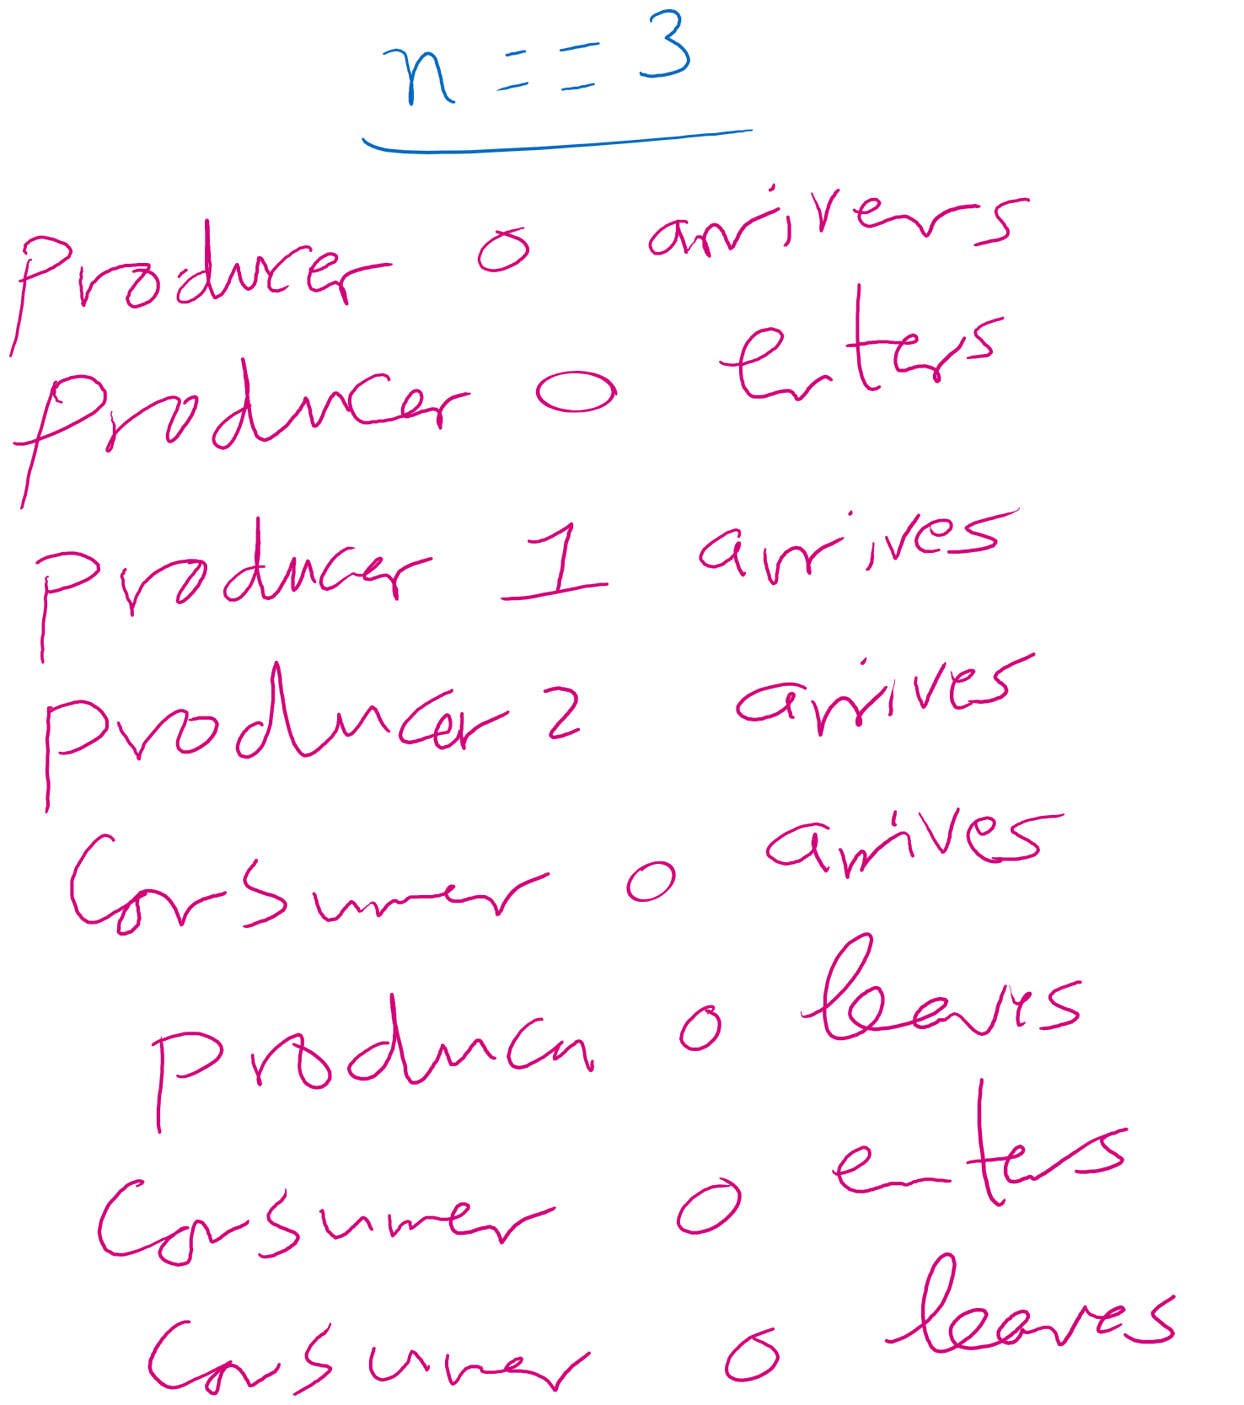
Example 1

Slide 23
Initial state
3
0
0
1

Slide 24
P0 arrives
3
0
0
1

Slide 25
P0 arrives
2
0
0
0

Slide 26
P0 enters
2
0
0
0

Slide 27
P0 enters
2
0
1
0

Slide 28
P1 arrives
2
0
1
0

Slide 29


P1 arrives
1
0
1
-1
Next, P2 arrives

Slide 30

P2 arrives
0
0
1
-2
Next, C0 arrives

Slide 31

C0 arrives
0
0
1
-2

Slide 32



C0 arrives
0
-1
1
-2

Slide 33
P0 leaves
0
-1
1
-2

Slide 34
P0 leaves
0
-1
1
-1

Slide 35
P0 leaves
0
-1
1
-1

Slide 36
P0 leaves
0
0
1
-1

Slide 37
C0 enters
0
0
1
-1

Slide 38
C0 enters
0
0
1
-2

Slide 39

C0 enters
0
0
1
-2

Slide 40
Can C0 enter?
0
0
1
-2

Slide 41
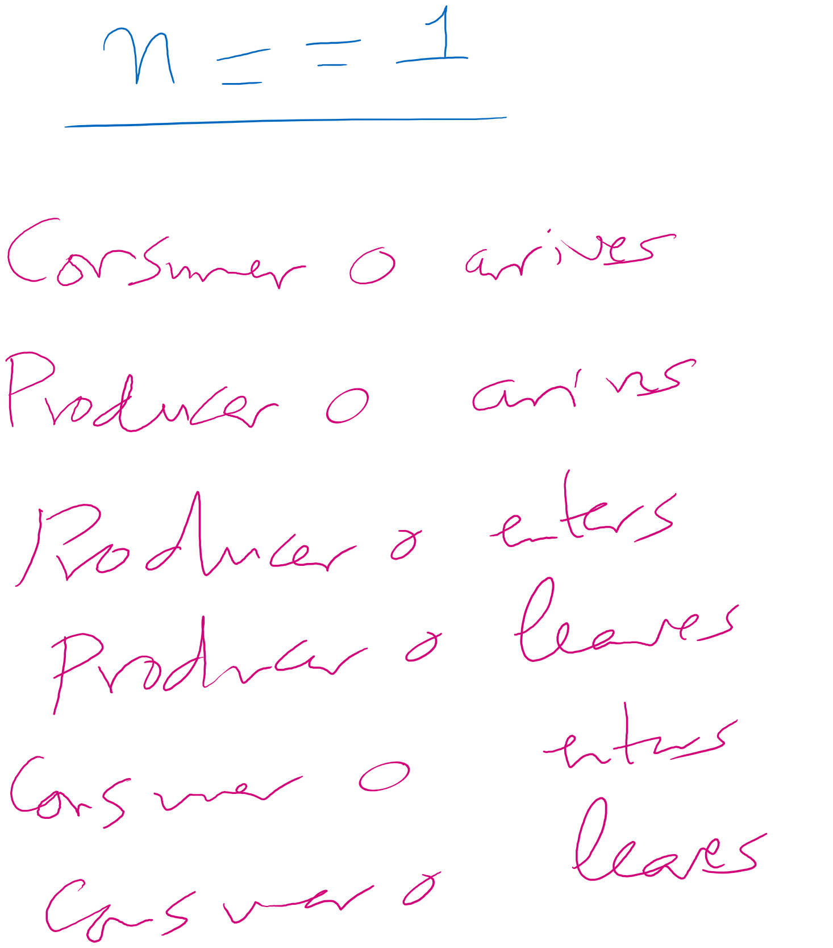
Example 2

Slide 42
Initial state
1
0
0
1

Slide 43
C0 arrives
1
0
0
1

Slide 44






C0 arrives
1
-1
0
1

Slide 45
P0 arrives
1
-1
0
1

Slide 46
P0 arrives
0
-1
0
1

Slide 47
P0 arrives
0
-1
0
0

Slide 48
P0 enters
0
-1
0
0

Slide 49
P0 enters
0
-1
1
0

Slide 50
P0 leaves
0
-1
1
0

Slide 51
P0 leaves
0
0
1
1

Slide 52
P0 leaves
0
0
1
1

Slide 53
C0 enters
0
0
1
1

Slide 54
C0 enters
0
0
1
0

Slide 55
Can C0 enter?
0
0
1
0

Slide 56
C0 enters
0
0
0
0

Slide 57
C0 leaves
0
0
0
0

Slide 58
C0 leaves
1
0
0
1

Slide 59
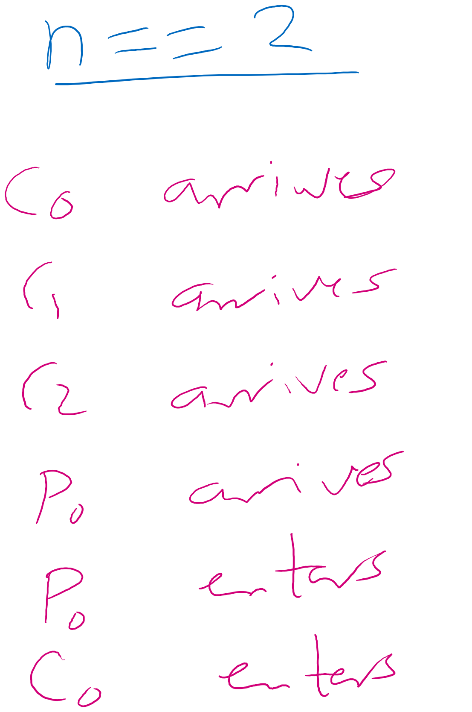
Example 3

Slide 60
Initial state
2
0
0
1

Slide 61
C0 arrives
2
0
0
1

Slide 62




C0 arrives
2
-1
0
1

Slide 63
C1 arrives
2
-1
0
1

Slide 64



C1 arrives
2
-2
0
1

Slide 65


C2 arrives
2
-2
0
1

Slide 66




C2 arrives
2
-3
0
1

Slide 67
P0 arrives
2
-3
0
1

Slide 68
P0 arrives
1
-3
0
1

Slide 69

P0 arrives
1
-3
0
0

Slide 70
P0 enters
1
-3
0
0

Slide 71
P0 enters
1
-3
1
0

Slide 72
C0 enters
1
-3
1
0

Slide 73
Can C0 enter?
1
-3
1
0

Slide 74
Produces Consumers Problem

Slide 75
Solving Producers Consumers using Semaphores

Slide 76
Is this sequence feasible?
n == 3
for (i=0; i<3; i++){
Pi arrives
Pi enters
Pi leaves
}
P3 arrives
C0 arrives
C0 enters
C0 leaves
P3 enters
P3 leaves

Slide 77
Some thoughts
If we have one producer and one consumer
do we need count?
do we need the mutex?
For multiple producers and consumers
what benefit do we get if we have one mutex for producers and one for consumers?

Slide 78
Warning!
It is easy to make mistakes when using semaphores

Slide 79

Let’s make a “small” change

Slide 80
Let’s make a “small” change
Semaphore empty(n), full(0);
Mutex sem(1);
Producer
down(sem)
down(empty)
buffer[in] = new item
in = (in + 1) % n
count++
up(empty)
up(sem)
Consumer
down(full)
down(sem)
Item = buffer[out]
out = (out + 1) % n
count--
up(sem)
up(full)

Slide 81
Is this sequence feasible?
n == 3
for (i=0; i<3; i++){
Pi arrives
Pi enters
Pi leaves
}
P3 arrives
C0 arrives
C0 enters
C0 leaves
P3 enters
P3 leaves

Slide 82
Solution
Condition Variables
Yet another construct (Add to Spinlock and Semaphore)
Has 3 operations
wait()
signal()
broadcast()
Not foreign to us at all
Every object variable in Java is a Condition Variable

Slide 83
Solution
Condition Variables operations must be called while holding a mutex lock
wait()
unlock mutex
block process
when awake, relock mutex
when successful, return
signal()
wakeup one waiting process in the condition variable’s queue if any
broadcast()
wakeup all waiting processes in the condition variable’s queue if any

Slide 84
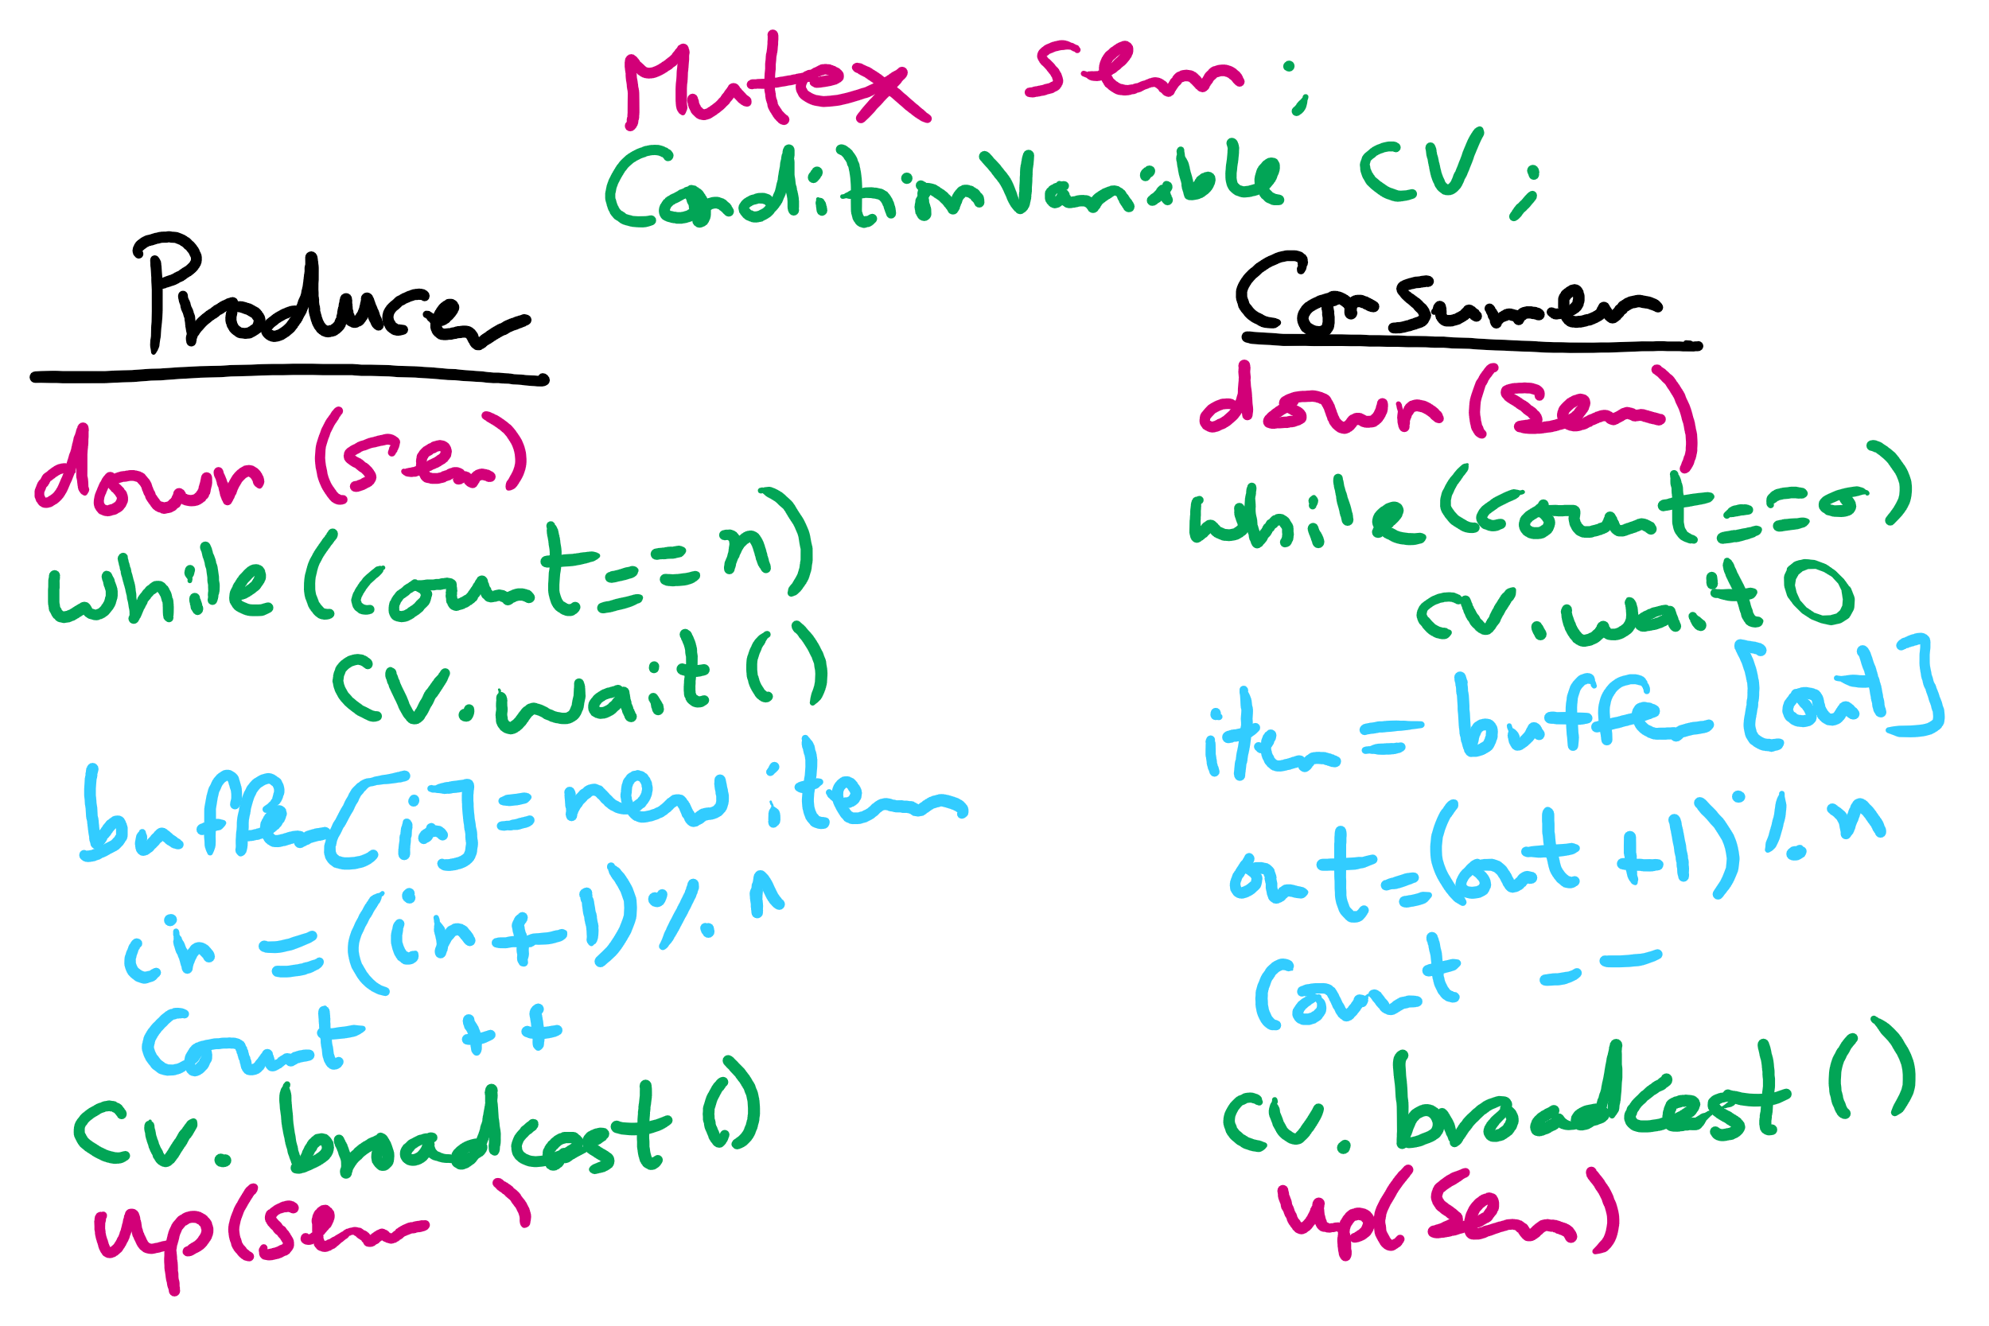
Solving Bounded Buffer Using Condition Variables

Slide 85
Solving Bounded Buffer Using Condition Variables

